Slide 1
ETHICAL DILEMMAS AND ETHICAL LAPSES

Slide 2
ETHICAL DILEMMA
An ethical dilemma is a choice between alternatives that may not be clearly right or clearly wrong.

Slide 3
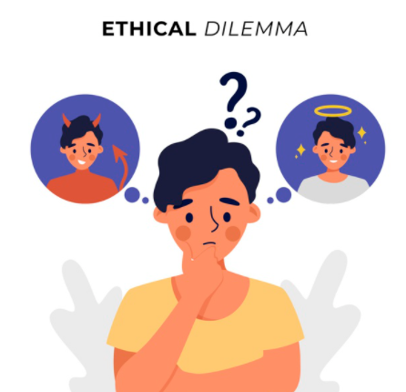
ETHICAL DILEMMA

Slide 4
ETHICAL DILEMMA
Employees naturally want higher wages and more benefits, but investors who have risked their money in the company want management to keep costs low so that profits are strong enough to drive up the stock price. Both sides have a valid ethical position.

Slide 5
ETHICAL LAPSES
An ethical lapse is making a choice you
know to be unethical.

Slide 6

ETHICAL LAPSES

Slide 7
ETHICAL LAPSES
Telling a potential customer you can complete a project by a certain date when you know you can’t is simply dishonest, even if you need the contract to save your career or your company.

